Slide 1
RLMO Round Table Meeting OIML-CS Update
Online meeting – 8 October 2020
Paul Dixon
BIML Assistant Director
OIML-CS Executive Secretary

Slide 2
Participation in the OIML-CS
AFRIMETS
APLMF
COOMET
GULFMET
SIM
WELMEC
ISSUING AUTHORITIES
UTILIZERS
ASSOCIATES

Slide 3
AFRIMETS
SADCMET: Angola, Botswana, Dem. Rep. Congo, Lesotho, Madagascar, Malawi, Mauritius, Mozambique, Namibia, Seychelles, South Africa, Swaziland, Tanzania, Zambia, Zimbabwe
SOAMET: Benin, Burkina Faso, Côte d'Ivoire, Guinea Bissau, Mali, Niger, Senegal, Togo
CEMACMET: Cameroon, Central African Republic, Chad, Congo Brazzaville, Equatorial Guinea, Gabon
EAMET: Burundi, Kenya, Rwanda, Uganda
MAGMET: Algeria, Mauritania, Morocco, Tunisia
NEWMET: Egypt, Ethiopia, Ghana, Libya, Nigeria, Sudan

Slide 4
APLMF
Australia, ​Brunei Darussalam, Cambodia, Canada, People's Republic of China, Hong Kong China, Indonesia, Japan, Kiribati, Republic of Korea, Malaysia, Mongolia, New Zealand, Papua New Guinea, Philippines, Singapore, Chinese Taipei, Thailand, United States of America, Vietnam
Chile, Colombia, DPR Korea, Laos D.P.R., Mexico, Peru, Russian Federation

Slide 5
COOMET
Armenia, Azerbaijan, Belarus, Bulgaria, Bosnia Herzegovina, People’s Republic of China, Cuba, DPR of Korea, Georgia, Germany, Kazakhstan, Kyrgyzstan, Lithuania, Moldova, Romania, Russia, Slovakia, Tajikistan, Ukraine, Uzbekistan

Slide 6
SIM
Noramet: Canada, Mexico, USA
Carimet: Antigua and Barbuda, Bahamas, Barbados, Dominica, Dominican Republic, Grenada, Guyana, Haiti, Jamaica , St. Lucia, St. Kitts and Nevis, St. Vincent and Grenadines, Suriname, Trinidad and Tobago
Camet: Belize , Costa Rica, El Salvador, Guatemala, Honduras, Nicaragua, Panama
Andimet: Bolivia, Colombia, Ecuador, Peru, Venezuela
Suramet: Argentina, Brazil, Chile, Paraguay, Uruguay

Slide 7
GULFMET
United Arab Emirates, Kingdom Of Bahrain, Kingdom Of Saudi Arabia, Sultanate Of Oman, State Of Qatar, State Of Kuwait, Republic Of Yemen
Bosnia And Herzegovina, Egypt, Turkey, Republic of Korea, Hong Kong

Slide 8
WELMEC
Austria, Belgium, Bosnia and Herzegovina, Bulgaria, Croatia, Cyprus, Czech Republic, Denmark, Estonia, Finland, France, Germany, Greece, Hungary, Iceland, Ireland, Italy, Kosovo, Latvia, Lithuania, Malta, Moldova, Montenegro, North Macedonia, Norway, Poland, Portugal, Romania, Serbia, Slovakia, Slovenia, Spain, Sweden, Switzerland, The Netherlands, Turkey, United Kingdom

Slide 9
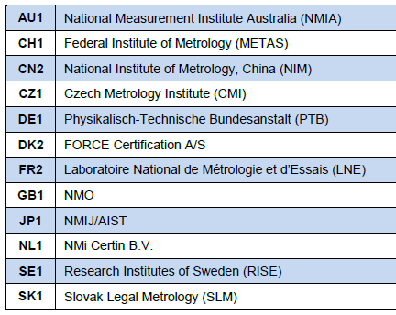
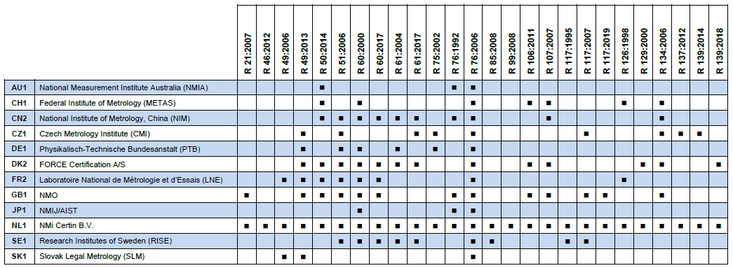
OIML Issuing Authorities
12 out of 61 Member States = 20%

Slide 10
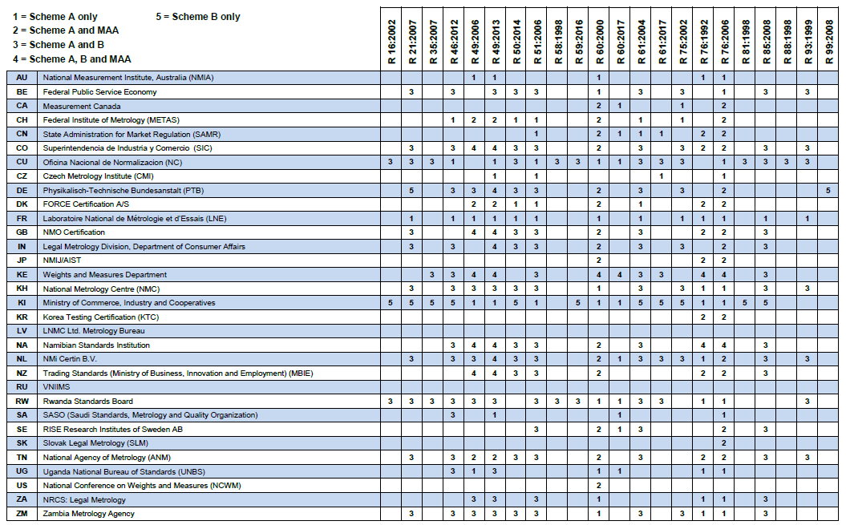
Utilizers and Associates
UTILIZERS: 27 out of 61 Member States = 44%
ASSOCIATES: 5 out of 63 Corresponding Members = 8%

Slide 11
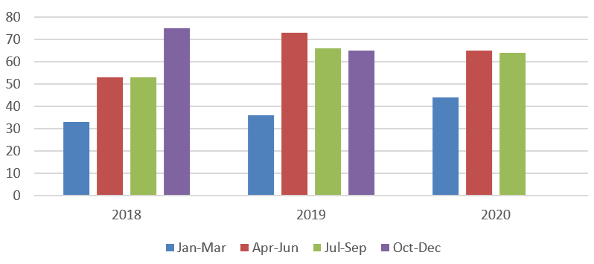
OIML-CS Certificates 1 January 2018 – 30 September 2020

Slide 12
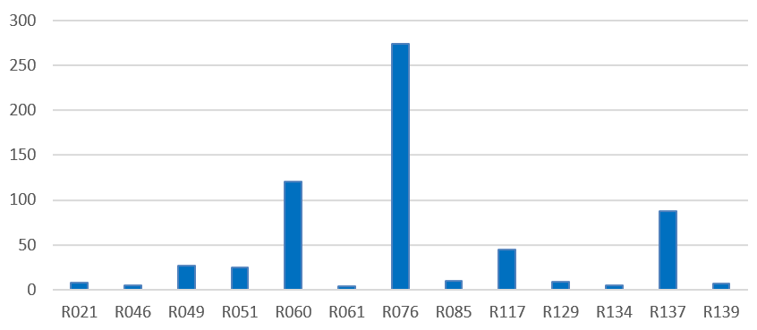
Certificates by Recommendation 1 January 2018 – 30 September 2020

Slide 13
OIML-CS Management Committee (MC)
OIML-CS MC meeting scheduled for 18-19 March 2020 in New Delhi was cancelled due to Covid-19
Three online MC meetings held on 19 May, 2 June and 2 July
Key items:
Mannie Panesar nominated for appointment as new MC Chairperson
Bill Loizides nominated for re-appointment as Deputy
Marking of instruments with the OIML certificate number

Slide 14
OIML-CS Management Committee (MC)
Key items (continued):
“Top-10” publications and periodic reviews
COVID-19 contingencies
Work being done to:
increase availability of Legal Metrology Experts, and
continue to raise awareness and increase participation in OIML-CS

Slide 15
OIML-CS Management Committee (MC)
OIML-CS MC online meeting to be scheduled for March 2021
COOMET, SIM and WELMEC are represented on the MC (as observers)
Nominations from AFRIMETS, APLMF and GULFMET are welcomed

Slide 16
Items for consideration
Promotional activities limited due to Covid-19 – identification of (online) events and opportunities
Proposals from RLMOs to increase participation of RLMO member economies in the OIML-CS as Utilizers or Associates
Identification of barriers to participation
How is the OIML-CS used to support national/ regional type approval
Regular updates to RLMOs (e.g. OIML-CS reports are provided to the APLMF for their Newsletter)

Slide 17
Paul DIXON
BIML Assistant Director
OIML-CS Executive Secretary
paul.dixon@oiml.org
www.oiml.org

